Slide 1
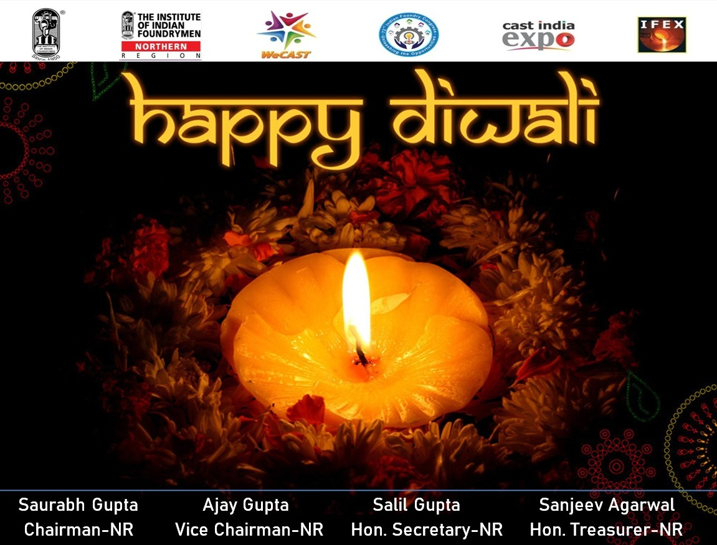

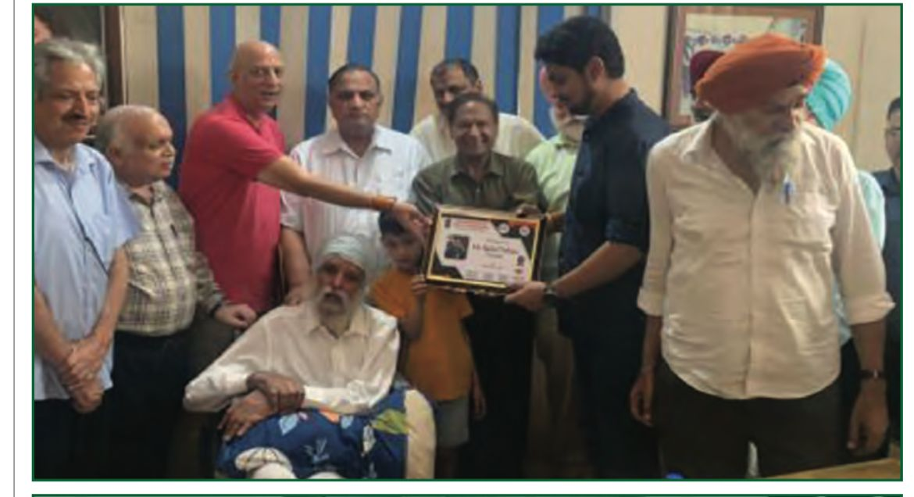
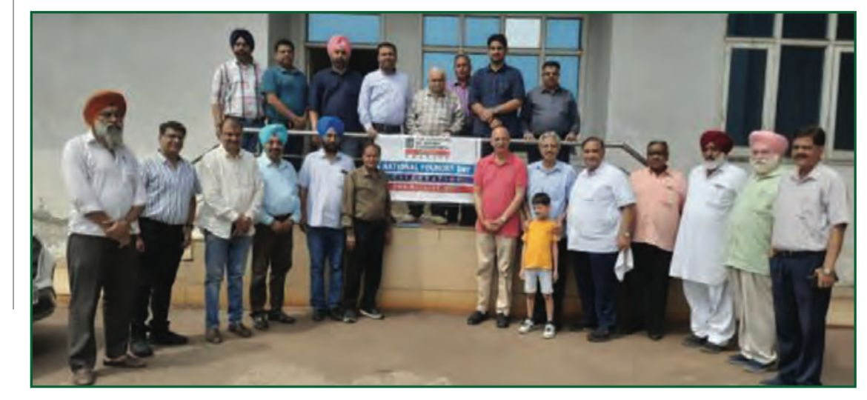
LIFE TIME MEMBER ACHIEVING AWARD CEREMONY
IIF-Batala Chapter celebrated the 74th National Foundry Day on Aug 24, 2023. IIF members along with their family members participated in the celebration. Ninety-two-year Mr S Avatar Singh of Rajindra Group of Industries was felicitated by presenting him with Lifetime Achievement Award for his outstanding contribution and support to foundry industry especially in the Batala region and to IIF-Batala Chapter.

